Slide 1
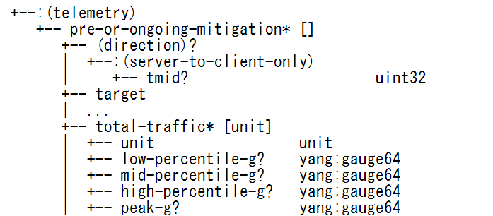
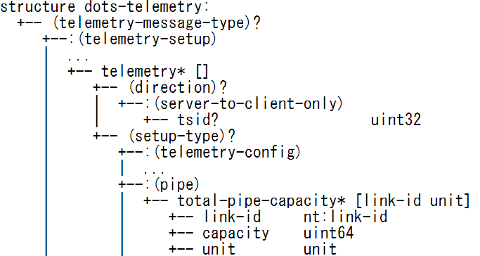
Router
Remaining Capacity
7Gbps
IF
Attack traffic B/W
2Gbps
Link Capacity
10Gbps
Normal traffic B/W
1Gbps
Remaining Capacity = (total-pipe-capacity) – (a percentile of total-traffic)

